Slide 1
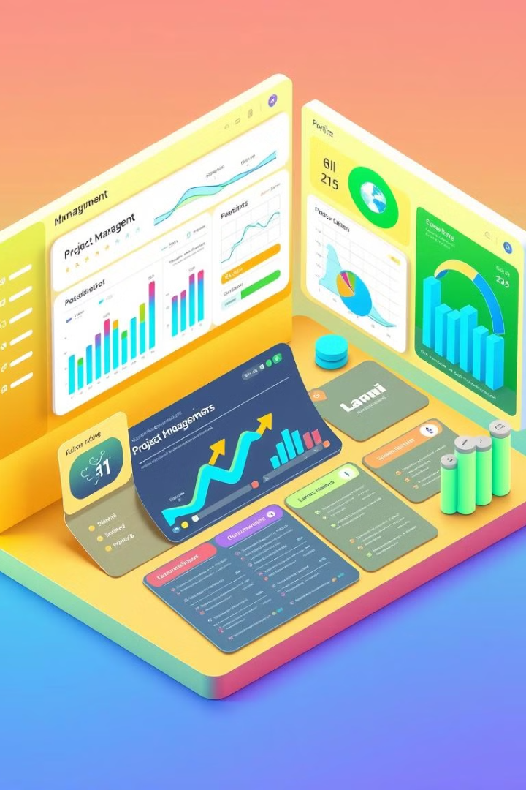

Unit 6: Project Implementation and Post-Implementation Activities: A Comprehensive Guide
This unit delves into the critical phases of project implementation. We'll cover strategic transitions and essential maintenance activities. This guide provides project managers with practical insights and actionable strategies.

Slide 2

Introduction to Implementation
1
Transforming Plans
Project implementation transforms plans into action.
2
Coordination
It requires strategic transitions and maintenance.
3
Key Areas
We'll cover programming management, system migration, change management, and post-implementation reviews.
4
Maintenance
Learn the basics of maintenance.

Slide 3
Managing the Programming Process
Methodologies
Tools
Team Roles
Spotify
Agile (Scrum, Kanban), Waterfall, and Hybrid approaches.
Utilize Jira, Trello, Asana, and Gantt charts for efficient tracking.
Project managers, developers, and QA specialists are key.
Explore Spotify’s squad framework as a case study.

Slide 4
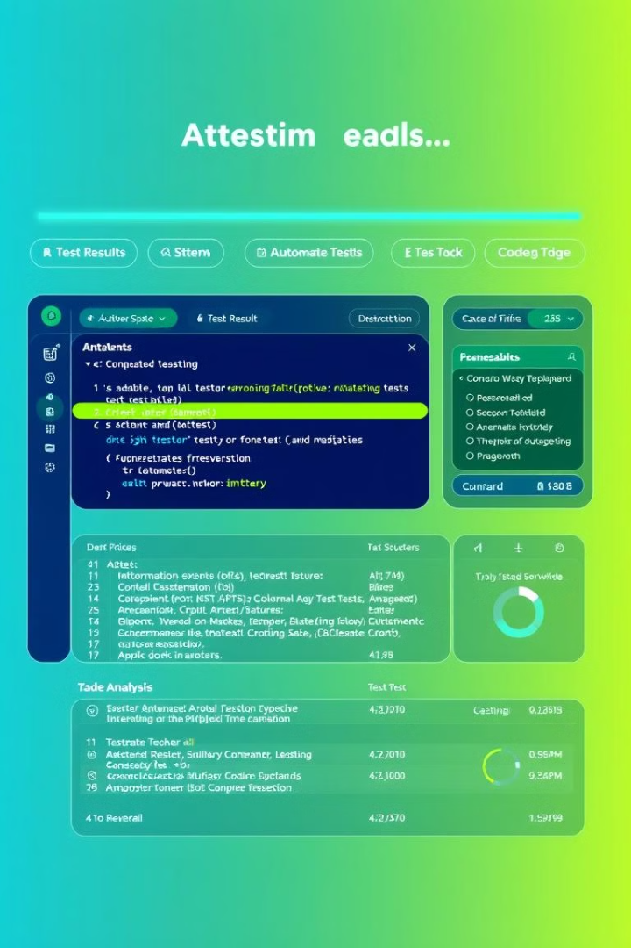
Testing Strategies
Unit Testing
Employ JUnit and pytest for individual component checks.
Integration Testing
Use API testing with Postman for system interactions.
System Testing
Evaluate performance with LoadRunner and security with OWASP ZAP.
Acceptance Testing
Implement UAT criteria and Beta testing in SaaS environments.

Slide 5





System Transition & Change Management
Direct Cutover
A high-risk, immediate transition.
Parallel Run
Run old and new systems simultaneously.
Phased Approach
Modular, gradual transitions.
Pilot Conversion
Test in a controlled environment.

Slide 6




Change Management
Resistance
Training
Communication
Mitigate resistance using Kotter’s 8-Step Model.
Use blended learning programs.
Plan communication, mapping stakeholders with RACI.

Slide 7

Post-Implementation Reviews & Maintenance
1
Process
Track KPIs like ROI and user satisfaction.
2
Tools
Use surveys and analytics for insights.
3
NHS Digital
Learn from NHS Digital’s COVID-19 app review.

Slide 8
Ongoing Maintenance
Types
ITIL
CI/CD
Google
Include corrective, adaptive, and perfective maintenance.
Apply ITIL for incident and problem management.
Use Jenkins and Docker for automation.
Google releases continuous Android OS updates.

Slide 9



Conclusion & Future Trends
DevOps
2
Collaborative approach.
AI Testing
1
Automated testing.
Zero Downtime
3
Seamless migrations.

Slide 10

Key Takeaways
1
Emerging Trends
2
Ethics
Focus on AI-driven testing and DevOps strategies.
Ensure GDPR compliance and accessibility.
3
Migration Plan
4
PIR
Use checklists for migration planning.
Utilize questionnaires for post-implementation reviews.

